Slide 1

Detection of mild depression in adolescents based on multimodal data from electroencephalogram and eye movement tracking
基于脑电图与眼动追踪多模态数据检测青少年轻度抑郁症
小组成员：舒XX、吴XX、赵XX、Illusionna
汇报时间：2026 年 6 月

Slide 2
Content
目录
01
Research background
02
Research Progress
03
Materials and methods
04
Analysis and Conclusion
05
References and About us

Slide 3
01
Research background

Slide 4

01
Research background
A Silent Struggle: How Do We See the Unseen?
(一场无声的挣扎：我们如何看见看不见的痛苦？)
Depression affects hundreds of millions, yet it often remains invisible.
Why is it so hard to detect accurately?
1
Notes:
Depression is not just a personal struggle; it's a global crisis. The WHO reports it affects over 280 million people. What's even more concerning is mild depression, a hidden epidemic that often flies under the radar, yet severely impacts lives. The economic and social toll is immense, underscoring the urgent need for better detection methods.

Slide 5
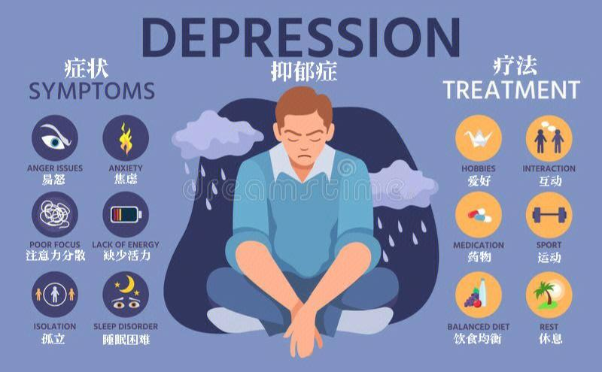
01
Research background
The Necessity of Research on the Incidence of Adolescent Depression:
Large Patient Base And Rising Trend：Global and Chinese data indicate that the detection rate of adolescent depression increases significantly with grade level.
Severe Burden And Profound Harm：Depression is the leading cause of disability in adolescents, easily triggering a sharp decline in academic performance and social withdrawal even lead to self-harm and suicide.
Large Service Gap And Low Recognition Rate: Clinical misdiagnosis and underdiagnosis are common. Most depressed adolescents do not receive standardized intervention. Beyond that, depression in adolescents is often overlooked in comparison to adults.
2
Notes:
Depression is not just a personal struggle; it's a global crisis. The WHO reports it affects over 280 million people. What's even more concerning is mild depression, a hidden epidemic that often flies under the radar, yet severely impacts lives. The economic and social toll is immense, underscoring the urgent need for better detection methods.

Slide 6




01
Research background
A Widespread Mental Health Crisis
According to the WHO, depression is a leading cause of disability worldwide, affecting an estimated 280 million people globally (as of 2023).
Mild Depression: A Hidden Epidemic
Often undiagnosed, mild symptoms significantly impair daily functioning and productivity, acting as a precursor to more severe depressive episodes.
Limitations of Traditional Diagnostic
Such as scale assessments and clinical interviews, rely heavily on subjective judgment and are prone to misdiagnosis and underdiagnosis.
3
Notes:
Depression is not just a personal struggle; it's a global crisis. The WHO reports it affects over 280 million people. What's even more concerning is mild depression, a hidden epidemic that often flies under the radar, yet severely impacts lives. The economic and social toll is immense, underscoring the urgent need for better detection methods.

Slide 7
01
Research background
Core Concepts
Eye-Tracking Technology 眼动追踪：Non-invasive technology, reflects human cognitive and emotional processing, its features can reflect attentional biases in depressed patients. (Focuses on external cognitive behavior)
EEG (Electroencephalogram) 脑电图：Non-invasive technology, records brain electrical activity, serves as a reliable neural biomarker for depression detection, with higher sampling frequency. (Focuses on internal brain neural activity)
Our research mainly focus on mild depression.
Mild depression refers to a less severe form of depression marked by persistent low mood over a long period.
It mostly occurs in adolescents and is often overlooked, even though it tends to relapse easily and needs early detection. In this study, it is specifically defined as a score between 32 and 38 on the DSM‑V (量表体系)depression scale for young people aged 11–17, and it can be recognized through unusual brain wave (EEG) and eye movement patterns.
4
Notes:
Depression is not just a personal struggle; it's a global crisis. The WHO reports it affects over 280 million people. What's even more concerning is mild depression, a hidden epidemic that often flies under the radar, yet severely impacts lives. The economic and social toll is immense, underscoring the urgent need for better detection methods.

Slide 8
02
Research Progress

Slide 9
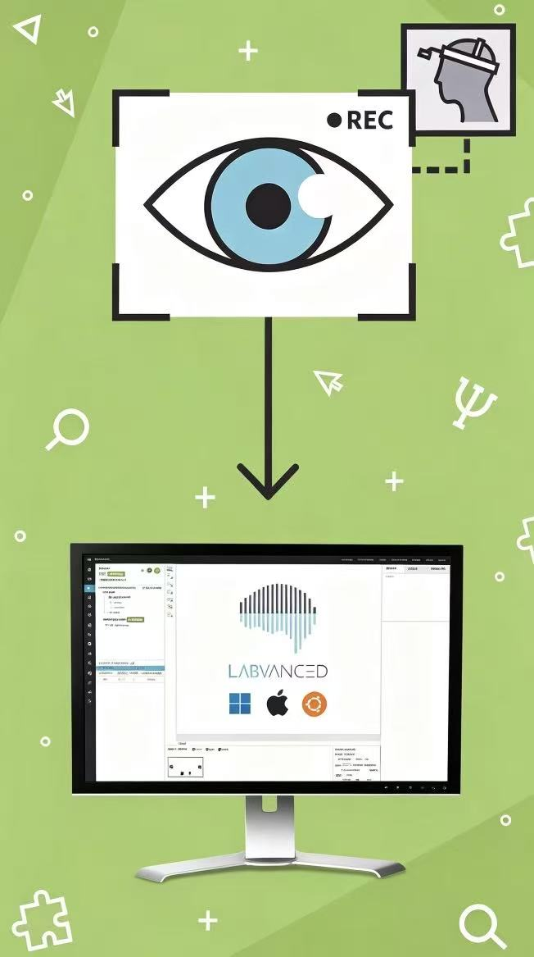
02
Research Progress
Part 1：Eye tracking in Depression Detection
Source | Methods | Results and conclusions | Limitations
Alghowinem et al. (2013) | First linked eye movement indicators with depression detection | Eye metrics reflect depressive attentional bias, building the foundation for application | Qualitative analysis only, no deep learning
Stolicyn et al. (2022) | Developed a depression assessment system | Extracted facial and eye-tracking features, 79% accuracy via SVM (classic machine learning model) | No mild depression classification, limited generalization
Yang et al. (2022) | Proposed a time-space eye pattern analysis method | Detected depressive visual attention patterns, 76.25% accuracy in distinguishing depressed from healthy subjects | Small sample size, low sensitivity to mild depression
5

Slide 10
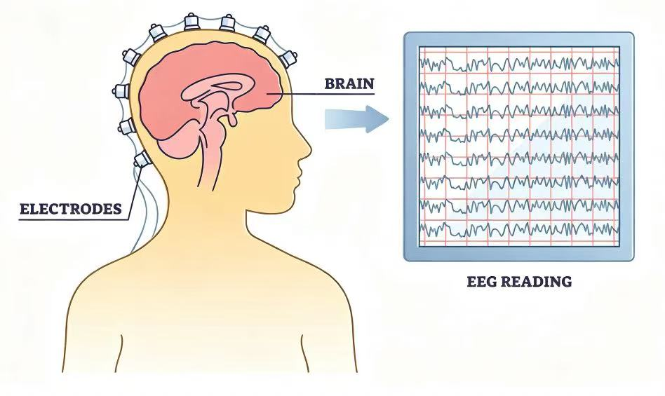
02
Research Progress
Part 2：EEG Research in Depression Detection
Mahato & Paul (2020) classified depressed and healthy subjects using EEG band features and SVM, achieving 88.33% accuracy.
Limitation: Traditional machine learning, manual feature extraction
Deep Learning
Deep learning extracts features automatically and effectively.
Yin et al. (2023) proposed a Transformer-CNN hybrid model, which outperforms previous methods.
Tigga & Garg (2023) introduced an attention-based Transformer model, achieving 98.67% accuracy in depression detection.
6

Slide 11

02
Research Progress
Multi-modal Data Fusion
Ding et al. (2019) classified major depressive disorder via EEG, eye-tracking and skin electrical signals, with 79.63% classification accuracy.
Limitation: Still in the initial stage, with insufficient research on mild depression.
Lack of efficient fusion strategies for EEG and eye-tracking in mild depression detection !
7

Slide 12
03
Materials and methods

Slide 13
03
Data collection and preprocessing
Ⅰ：Subject Information
group | number of people | average age | inclusion criteria
Mild to moderate depression | 21 | 16.5 | DSM-V score: 32 - 38
health comparison | 28 | 17.5 | No depressive symptoms
Ⅱ：Experimental paradigm and equipment
Driving scenario: 20 trials, including sudden appearance of pedestrians and vehicle collisions
EEG equipment
Eye-tracking device
Ⅲ： Preprocessing and Feature Extraction
modal | feature extract extraction
EEG | statistical characteristic、Hjorth、nonlinear character
Eye-tracking | AOI sample percentage, AOI fixation time, fixation distribution
8

Slide 14

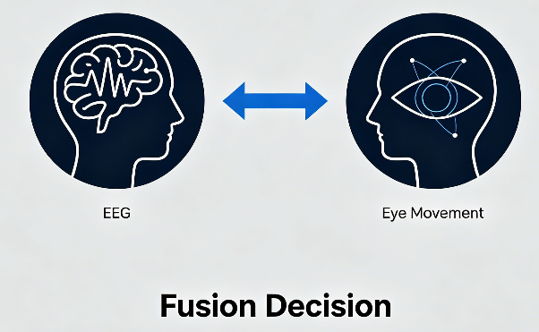
03
Multimodal fusion strategy
Traditional machine learning
Deep learning fusion - MTNet
vs
Disadvantages:
The features extracted manually may not be comprehensive enough.
Simple concatenation ignores the deep interrelationship between the two types of data.
Advantages:
Automatically extract the most effective features
It is possible to learn the complex relationships between two types of data.
The effect has been significantly improved.
The traditional method is like "simply cutting the ingredients and mixing them together", while our MTNet is like "asking two experts to analyze separately and then discuss together". Therefore, it can discover more detailed and specific information related to depression.
9

Slide 15
Early vs. Middle vs. Late
03
The influence of different integration stages
Early fusion: Input layer directly concatenates raw features → FCNN
Intermediate fusion (adopted by MTNet): Features of each modality are extracted separately and then fused in the hidden layer.
Late fusion: Each modality is independently modeled, and the prediction results are weighted averaged (average weighted / entropy weighted)
Integration stage | accuracy rate | sensitivity | specificity | F1 score
Early integration | 85.91% | 85.00% | 82.76% | 0.837
Intermediate integration | 91.79% | 90.48% | 92.86% | 0.904
Late fusion | 89.71% | 90.00% | 89.66% | 0.878
Intermediate fusion of the best: Capable of effectively adapting to the heterogeneity of multimodal data and capturing the interactions between modalities
MTNet + Intermediate Fusion achieves the best detection performance (91.79%), which is superior to single-modal and feature-level fusion.
10

Slide 16
04
Analysis and Conclusion

Slide 17
04
Analysis and Conclusion
Target object: 49 adolescents; mild depression: DSM-V youth scale 32-38; reported MTNet; accuracy 91.79%, F1 score 0.904.
11

Slide 18


04
Analysis and Conclusion
Key readout
Eye-tracking only (best ML)
75.61%
Best accuracy
91.79%
EEG only (best ML)
81.62%
Feature-based fusion (SVM)
83.70%
F1-score peak
0.904
EEG-only Transformer
87.87%
MTNet intermediate fusion
91.79%
+8.09% over feature-based fusion
Signal story: eye behavior + EEG neural activity > Transformer-based intermediate fusion > stronger screening performance
12

Slide 19
04
Analysis and Conclusion
Error Analysis: Why Is MTNet Better for Screening?
The intermediate fusion setting cuts total mistakes in half and reduces missed mild-depression cases.
Feature-based
Early
Intermediate
Late
24
Correct HC
4
False alarm
25
Correct HC
3
False alarm
26
Correct HC
2
False alarm
26
Correct HC
2
False alarm
4
Missed MD
17
Correct MD
4
Missed MD
17
Correct MD
2
Missed MD
19
Correct MD
3
Missed MD
18
Correct MD
Total errors: 8 Missed MD: 4
Total errors: 7 Missed MD: 4
Total errors: 4 Missed MD: 2
Total errors: 5 Missed MD: 3
Intermediate fusion significantly reduces misclassification, cutting total errors from 8 to 4 and missed mild-depression cases from 4 to 2.
MTNet provides a more balanced screening result, achieving high sensitivity and specificity while reducing the risk of missed depression detection.
13

Slide 20
05
References and About us

Slide 21
05
References
Das, Abhishek, et al. "Human attention in visual question answering: Do humans and deep networks look at the same regions?." Computer Vision and Image Understanding 163 (2017): 90-100.
Chlasta, Karol, et al. "AI-Based Screening for Depression and Social Anxiety Through Eye Tracking: An Exploratory Study." arXiv preprint arXiv:2503.17625 (2025).
Zhu, Jing, et al. "An improved classification model for depression detection using EEG and eye tracking data." IEEE transactions on nanobioscience 19.3 (2020): 527-537.
Zheng, Zhiguo, et al. "Diagnosing and tracking depression based on eye movement in response to virtual reality." Frontiers in Psychiatry 15 (2024): 1280935.
Lee, S., S. Kim, and K. M. Lee. "Depression detection using virtual avatar communication and eye tracking." Frontiers in Psychiatry 13 (2022): 10699095.
Zhu, Jing, et al. "Multimodal mild depression recognition based on EEG-EM synchronization acquisition network." IEEE Access 7 (2019): 28196-28210.
Zhu, Jing, et al. "Transformer-based fusion model for mild depression recognition with EEG and pupil area signals." Medical & Biological Engineering & Computing 63.7 (2025): 2011-2027.
Stolicyn, A., J. D. Steele, and P. Seriès. "Prediction of depression symptoms in individual subjects with face and eye movement tracking." Psychological Medicine 52.9 (2022): 1784-1792.
Yang, M., et al. "Clustering based on eye tracking data for depression recognition." IEEE Transactions on Cognitive and Developmental Systems (2022).
Mahato, S., and S. Paul. "Classification of depression patients and normal subjects based on electroencephalogram (EEG) signal using alpha power and theta asymmetry." Journal of Medical Systems 44 (2020): 1-8.
11. Yin, F., et al. "Depression detection in speech using transformer and parallel convolutional neural networks." Electronics 12.2 (2023): 328.
Tigga, N. P., and S. Garg. "Efficacy of novel attention-based gated recurrent units transformer for depression detection using electroencephalogram signals." Health Information Science and Systems 11.1 (2023): 1-17.
Ding, X., et al. "Classifying major depression patients and healthy controls using EEG, eye tracking and galvanic skin response data." Journal of Affective Disorders 251 (2019): 156-161.
Zhu, J., et al. "Toward depression recognition using EEG and eye tracking: an ensemble classification model CBEM." 2019 IEEE International Conference on Bioinformatics and Biomedicine (BIBM). IEEE, 2019.

Slide 22
05
About us
Zhao Poling
Shu Anqi
Control the process
Clearly assign tasks to team members
Complete the research methods section
Complete the research background section
Provide the presentation outline
Wu Qirui
Ye Binghui
Complete the research progress section
Provide suggestions for revisions
Complete the data analysis and result section
Provide professional guidance.

Slide 23
Thank you for listening!

